Slide 1
CIPD Coronavirus webinar series
Supporting the mental wellbeing of frontline workers
06 May 2021

Slide 2
Welcome
Lesley Richard, Head of CIPD Wales, CIPD

Slide 3
Today’s speakers
Lesley Richards
Head of CIPD Wales,
CIPD
Ben Willmott
Head of Public Policy,
CIPD
Gail Kinman
Visiting Professor of Occupational Health Psychology, Birbeck University of London
Steve Lee
Interim Head of Health and Wellbeing, NHS England and Improvement

Slide 4










#StrongerWithCIPD
Covid-19 resources
NEW Well-being helpline
Employment Law helpline
Communities and branches
People Management
Knowledge and content
Free learning
Careers support
Professional creditability
Financial support
cipd.co.uk/memberbenefits

Slide 5
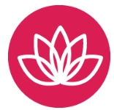
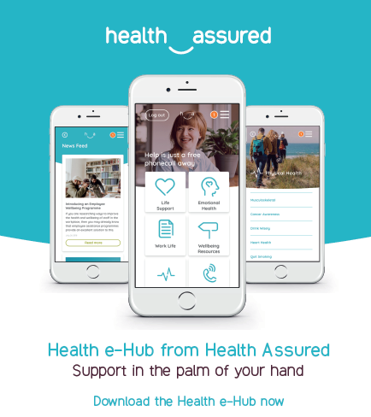
*New* Wellbeing Resources
We’ve partnered with Health Assured to support members mental health and wellbeing
Unlimited free 24/7 confidential telephone helpline, online portal & Health e-Hub app
The resource provides:
  Legal information
  Debt and financial information
  Manager consultancy and support
  Information on work and home issues
  Factsheets, advice, information and self-help tools
  Links to specialist support organisations
  A resources area with; programmes, videos, webinars, medical information and mini health checks.

Slide 6
Supporting the wellbeing of frontline workers
Ben Willmott, CIPD

Slide 7
Costs of poor mental health at work – key facts
Thriving at Work: the Stevenson-Farmer review of mental health estimated the costs to employers of mental health illness of between £1,205 and £1,560 per year – between £33 billion and £42 billion a year (Deloitte 2017).
This is made up of:
absenteeism cost: £8 billion
presenteeism cost: £17 billion to £26 billion
staff turnover: £8 billion.

Slide 8
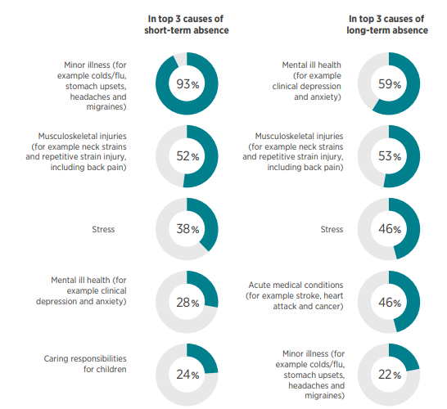
Top causes of employee absence

Slide 9
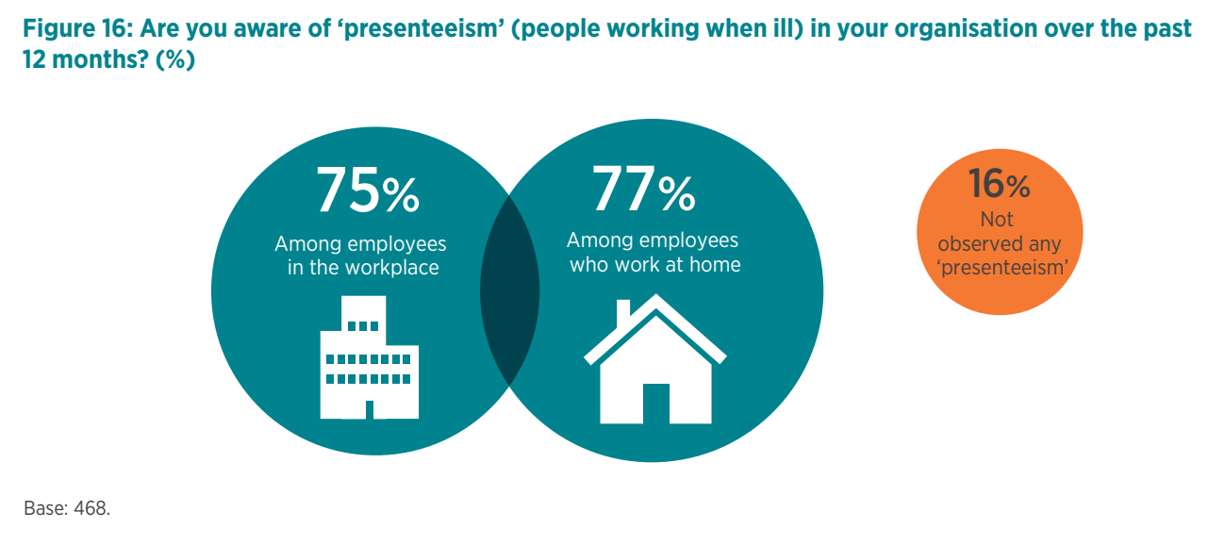
Increased presenteeism is associated with increases in reported common mental health conditions as well as stress-related absence

Slide 10
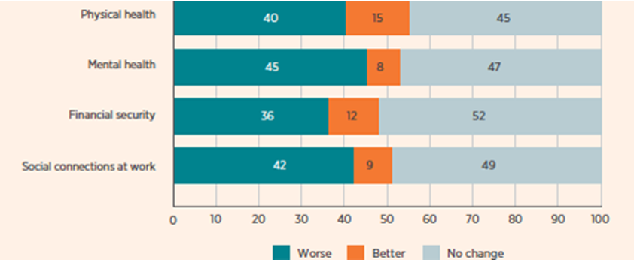
Impact of Covid-19 lockdown on employee health and wellbeing
Employees: As a result of the COVID-19 lockdown, are the following better or worse off?

Slide 11
Factors that can undermine mental wellbeing of front-line workers
Interaction with customers/patients/members of the public
Less access to flexible working, including home-working
Less control over their work
Low pay/financial concerns
Anti-social/long hours

Slide 12
Managing and preventing stress key
"The adverse reaction people have to excessive pressure or other types of demand placed upon them," - HSE
Chronic stress is linked to higher risk of conditions such as anxiety and depression as well as heart disease
Stress can impair people's cognitive ability and undermine their judgement, ability to prioritise and increase the likelihood of mistakes/accidents

Slide 13
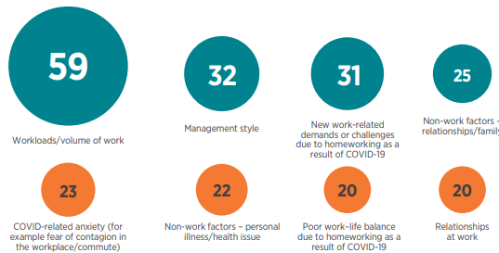
Main causes of stress at work

Slide 14
Good people management foundation for employee health and wellbeing
Being open, fair and consistent
Handling conflict and people management issues
Providing knowledge, clarity and guidance
Building and sustaining relationships
Supporting development

Slide 15

Early intervention and support key
“It’s normal behaviour for me to withdraw from everyone when I’m going through a bad patch, which inevitably ends up as a crisis. Having a manager who makes a point of looking out for everyone has changed my life.”

Slide 16
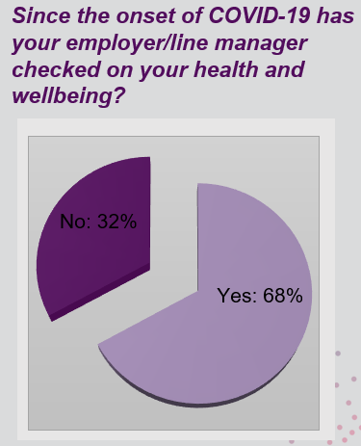
CIPD Health and Wellbeing report 2021 – employee viewpoint

Slide 17

Managers need to pick up on signs of poor mental health
People working long hours and not taking breaks
Lateness, leaving early or extended lunches
Absenteeism
Presenteeism
Uncharacteristic changes in emotional response
Impaired/inconsistent performance
Out-of-character conflict with colleagues

Slide 18
Supporting employees with mental health difficulties
Return to work interviews
Flexible working
Early access to OH services for anyone reporting stress/mental health problems
Reasonable adjustments
Phased/flexible return to work after time off for ill health
Employee Assistance Programme
Financial wellbeing support

Slide 19
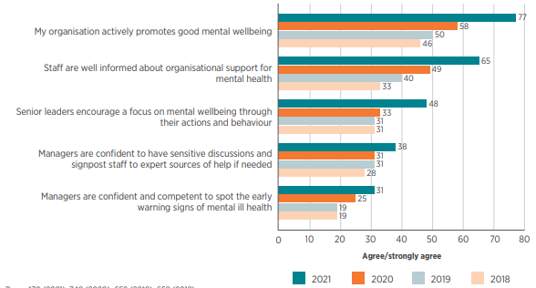
Effectiveness in promoting/supporting positive mental health

Slide 20
Business case for supporting employee mental health at work
Legal duty of care/costs
Reduced absence/presenteeism
Motivation/performance
Accidents/mistakes
Staff retention

Slide 21


CIPD Coronavirus webinar series:
Supporting the mental wellbeing of frontline workers
Dr. Gail Kinman
Visiting Professor of Occupational Health Psychology

Slide 22
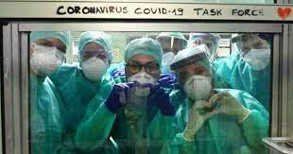


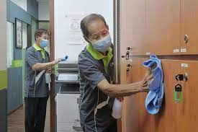
COVID-19: mental health
Unprecedented demand
Mental health and wellbeing in UK population has generally deteriorated
Frontline and key workers are disproportionately affected
Health and social care workers at higher risk; also security guards, drivers, cleaners

Slide 23
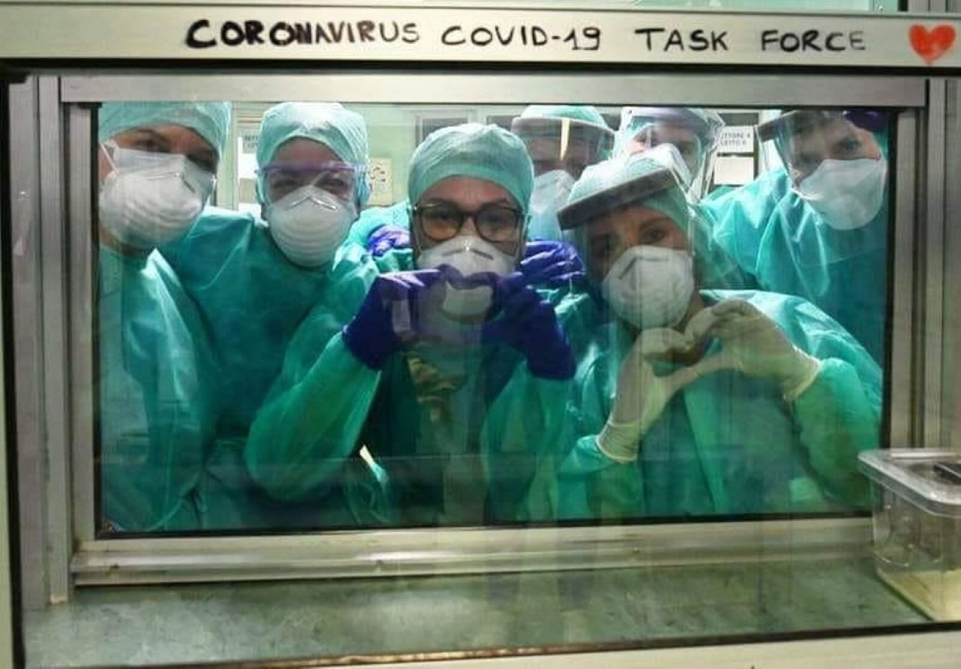
COVID-19: Healthcare workers
Long hours, higher intensity, few breaks = exhausted and depleted
Burnout a key concern, but high risk of stress, depression and anxiety
PTSD increased, linked to moral injury and compassion fatigue
COVID-related stress; concerns for self/family safety; financial insecurity
Increased demand for counselling and support; difficulty with access
Impaired performance/patient safety concerns
High sickness absence; also sickness presenteeism
Concerns about retention: many intend leaving or retiring early
Greenberg et al. 2020
IPPR/YouGov, 2020
Pearman et al. 2020
Kinman & Teoh, 2019/2020
BMA Tracker
Williamson et al. 2020
Notes:
Use of BMAs mental health helpline has risen by 80 % this year
Difficulty accessing support due to short staffing and post code lotery

Slide 24
Improving wellbeing: a multi-level approach
Evidence-informed
interventions needed
at all levels
Notes:
Interventions are required at each level
Interpersonal competencies – use of social support and supervision
Much more research and evaluation needed

Slide 25
Interventions: what works?
Include psychoeducation, self-compassion, mindfulness, CBT, reflective groups
Tertiary: supporting people back to work
Primary: tackling stress at source
Secondary: helping people cope more effectively
Provide a safe working environment that supports health
Ensure OH services are properly resourced and trained
Use technology for training and support (can increase access)
Involve staff in shaping interventions; enable job crafting
Train and support managers to support the wellbeing of staff
Recognise and address ‘hidden’ risks: e.g. presenteeism and change fatigue
Provide mental health tools and support and encourage access
Promote an open culture – tackle stigma and ensure support is inclusive
Assess risk; diagnose hazards (also remote staff); implement/evaluate interventions
Ensure interventions are evidence-informed, appropriate, accessible (in one place)
Better communication between OH staff and managers to negotiate return and adjustments
Ensure return to work is as smooth as possible – managers have a key role here
Spot signs of struggle; encourage peer support and mentoring
Enable access to timely support and appropriate treatments
Support flexible working/hybrid approaches
Availability & Access
Stigma
Notes:
Very little evaluation of primary interventions

Slide 26

Health and Wellbeing – the response and next steps
Steve Lee
People Directorate, Health & Wellbeing Team
May 2021
NHS England and NHS Improvement

Slide 27






Health and wellbeing overview
636,914 website sessions
197,985 app downloads
14,808 contacts with
our dedicated helplines
7,465 primary care coaching sessions
Supporting BAME colleagues
464 coaching bookings
120 sign ups for MHFA
48 sign ups for strength coaching training
Physical wellbeing with Invictus Games:
2,000 webpage views
‘5k Our Way’ videos viewed 8,225 times
Successful IGF podcast series launch
22 wellbeing webinars with 15,000+ views
Virtual events for Wellbeing Guardians, Primary care, enhanced HWB projects, wellbeing conversations – over 700 participants
At 4 April 2021

Slide 28
Barriers to accessing HWB support
Time – staff not having / being given / feeling they don’t have time to access support
Awareness – a significant number of respondents reported that they weren’t aware of the national offer
Lack of trust – feeling it would get back to their manager and be used against them, general lack of trust
Feeling too tired/overwhelmed to even think about what support might help them
Not wanting to admit they need help
Issues with IT/access/signing up for apps
The offer was overwhelming and not sure what support is right for them
Staff not feeling they need to access HWB support – don’t need or have other sources of support (eg family)
‘No barriers’ – a number of staff responded ‘no’, indicating they are comfortable accessing HWB support
Themes arising from 783 staff responses to the question: Has anything stopped you or put you off accessing health and well-being support?

Slide 29
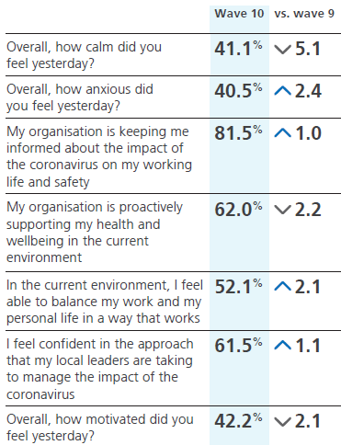
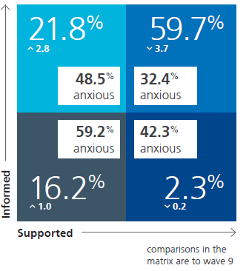
The Pulse Survey suggests that staff generally feel well supported - and that when they do, it reduces stress
Pulse survey – 121 NHS employers registered, 36,657 respondents across all 10 waves so far
Throughout COVID, staff generally have felt well supported (62-69%) and well informed (80-85%)
The combination of these two factors leads to measurably lower levels of anxiety (32.4% versus average of 40.5% for all NHS staff), as shown below;
Staff report being more anxious about health of their immediate family (84.8%) and own health (58.1%)
The level of anxiety felt by staff has continued to rise in recent months and has now exceeded the level of the rest of the UK workforce (35%)

Slide 30
The NHS staff health and wellbeing offer
It is important that the health and wellbeing offer continues to evolve and our focus will be on three main areas:
  We need to ensure Health and Wellbeing Guardians are supported in their role and champion health and wellbeing consistently within organisations – we have held webinars tailored for different audiences and are working with the Health and Safety Executive to develop an indicator tools that Guardians can use to assess HWB performance
  We need to equip line managers and teams with the tools they need take ownership of health and wellbeing and that supportive, compassionate, conversations take place routinely
  We need to continue to deploy evidence-based interventions on mental health that staff can access rapidly, while also promoting the current offer; and have a focus on Occupational Health becoming an integral part of a preventative health and wellbeing management system to help organisations develop and own interventions
We believe we need to have a focus on these activities while ensuring that ‘people recovery’ sits at the heart of what we do.

Slide 31
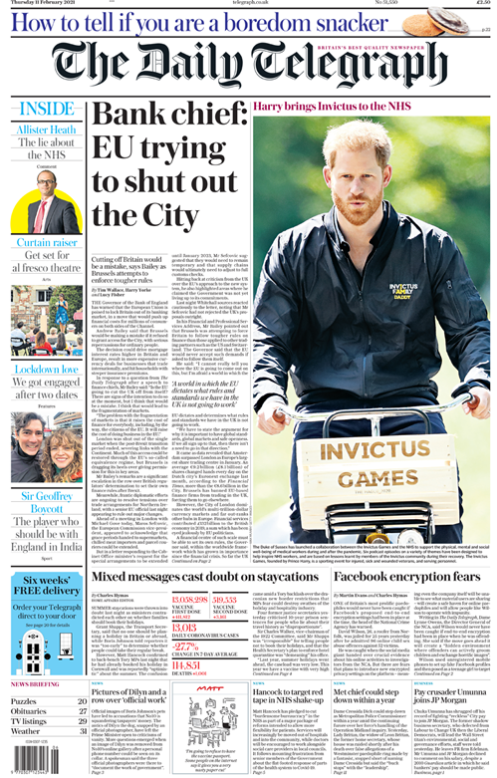
We continually refine the support offer to staff
Extending free access to health and wellbeing apps to NHS staff
Development of an accessible physical health offer in partnership with Invictus Games Foundation
Financial wellbeing support in partnership with the Money and Pensions Service (MAPS)
Violence reduction training and extending the pilot of body-worn cameras in the ambulance sector
Implementing H&WB conversations for all NHS staff, practitioner guide produced and signposting to NHS Employers user guides
Introducing ‘Leadership lifeguards’ to provide coaching and support to line managers
Further development and research into the offer to BAME staff and networks, including working in partnership with faith groups
Family and relationship support in partnership with specialist providers
The effectiveness and reach of the HWB support is tracked and evaluated week by week
to refine and respond to what staff need and what they seem to value most highly

Slide 32
Questions
Please submit your questions for:
  Ben Willmott, Head of Public Policy, CIPD
  Gail Kinman, Visiting Professor of Occupational Health Psychology, Birbeck University of London
  Steve Lee, Interim Head of Health and Wellbeing, NHS England and Improvement
Please use the Q&A function to submit your questions

Slide 33
#StrongerWithCIPD
Covid-19 resources
NEW Well-being helpline
Employment Law helpline
Communities and branches
People Management
Knowledge and content
Free learning
Careers support
Professional creditability
Financial support
cipd.co.uk/memberbenefits

